Slide 1
Chapter 3 Combinational Logic Design
Encoder, Decoder and Multiplexer Exercises

Slide 2
DESIGN PROCEDURE STEPS
1. Specification: Write a specification for the circuit, if one is not already available.
2. Formulation: Derive the truth table or initial Boolean equations that define the required relationships between inputs and outputs.
3. Optimization: Apply two-level and multiple-level optimization. Draw a logic diagram or provide a netlist for the resulting circuit using ANDs, ORs, and inverters.
4. Technology Mapping: Transform the logic diagram or netlist to a new diagram or netlist using the available implementation technology.
5. Verification: Verify the correctness of the final design.

Slide 3
BEGINNING HIERARCHICAL DESIGN
A “divide-and-conquer” approach called hierarchical design, and the resulting related symbols and schematics constitute a hierarchy representing the circuit designed.
In order to deal with circuit complexity, the circuit is broken up into pieces we call blocks.
The blocks are interconnected to form the circuit. The functions of these blocks and their interfaces are carefully defined, so that the circuit formed by interconnecting the blocks obeys the initial circuit specification.

Slide 4
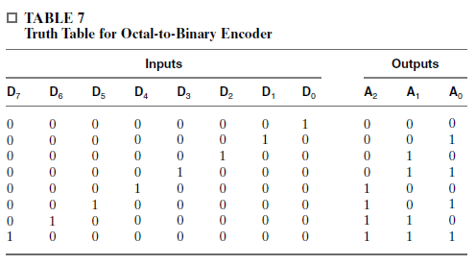

Encoder
An encoder is a digital function that performs the inverse operation of a decoder.
An encoder has 2n (or fewer) input lines and n output lines. The output lines generate the binary code corresponding to the input value.

Slide 5
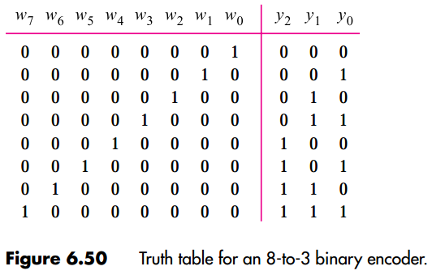
Encoder: Question
From the book Fundamentals of Digital Logic with VHDL Design; 2nd edition

Slide 6
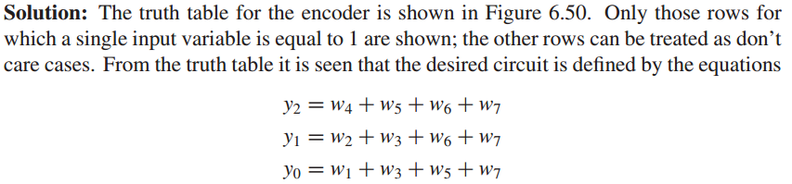
Encoder: Answer
From the book Fundamentals of Digital Logic with VHDL Design; 2nd edition

Slide 7
Decoder
a combinational circuit with an n-bit binary code applied to its inputs and an m-bit binary code appearing at the outputs.
The decoder may have unused bit combinations on its inputs for which no corresponding m-bit code appears at the outputs.

Slide 8
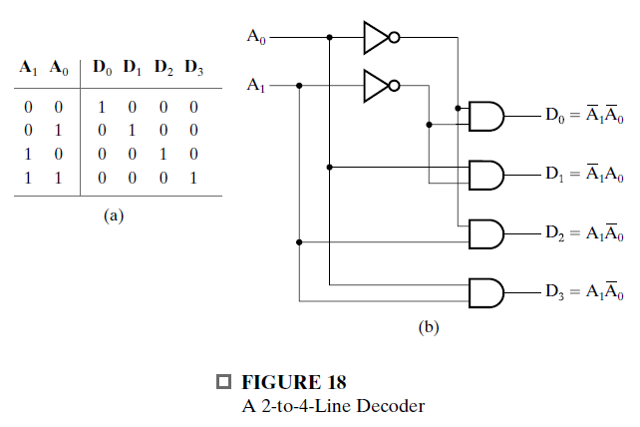
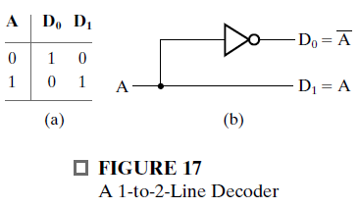
Decoder implementions and truth tables

Slide 9
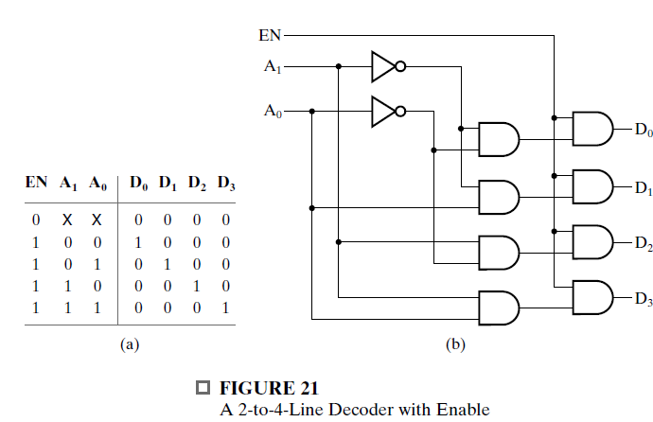
Decoder with Enable

Slide 10
Multiplexer
A multiplexer is a combinational circuit that selects binary information from one of many input lines and directs the information to a single output line.
The selection of a particular input line is controlled by a set of input variables, called selection inputs.

Slide 11
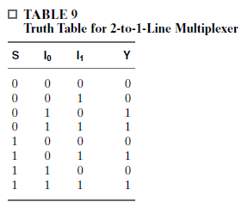
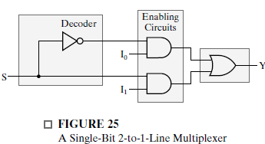
Multiplexer

Slide 12
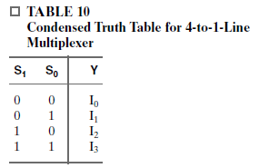
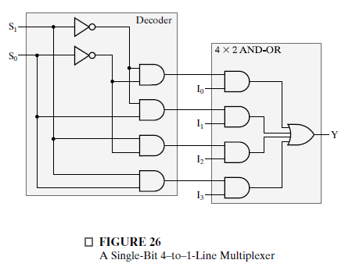

Slide 13
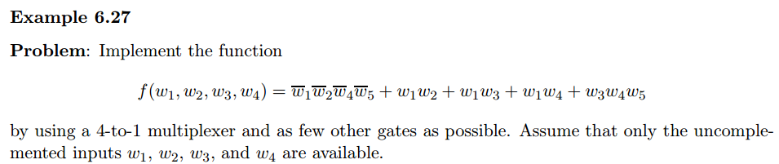
From the book Fundamentals of Digital Logic with VHDL Design; 2nd edition
MUX : Question

Slide 14
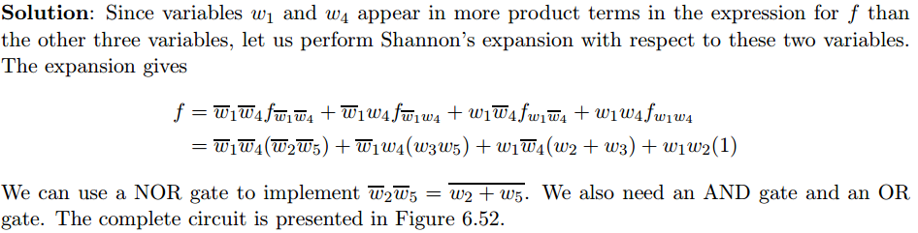
MUX: Answer
From the book Fundamentals of Digital Logic with VHDL Design; 2nd edition

Slide 15
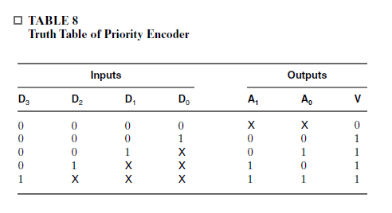
Question 2
Examples from the course book
Design a 4-input priority encoder with inputs and outputs as in Table 8, but with the truth table representing the case in which input D0 has the highest priority and input D3 the lowest priority

Slide 16
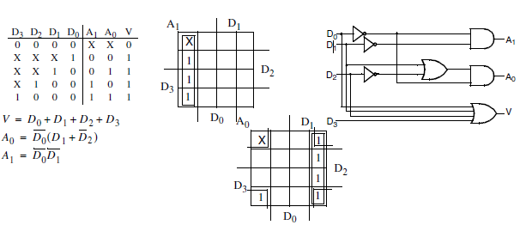
Answer 2

Slide 17
Question 3
*Construct a 15-to-1-line multiplexer with two 8-to-1-line multiplexers.
Interconnect the two multiplexers and label the inputs such that any added logic required to have selection codes 0000 through 1110 is minimized.

Slide 18
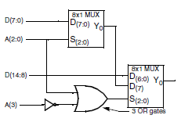
Answer 3

Slide 19
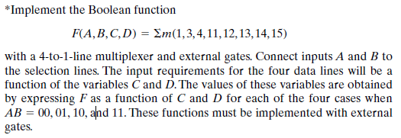

Question 4

Slide 20
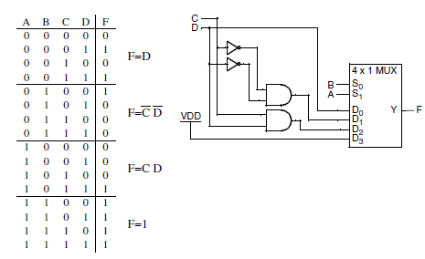
Answer 4

